Slide 1
SkLearn Datasets

Slide 2
Outline:
Sklearn Datasets
Description of IRIS Plant Datasets
3. Description of Diabetes Dataset

Slide 3
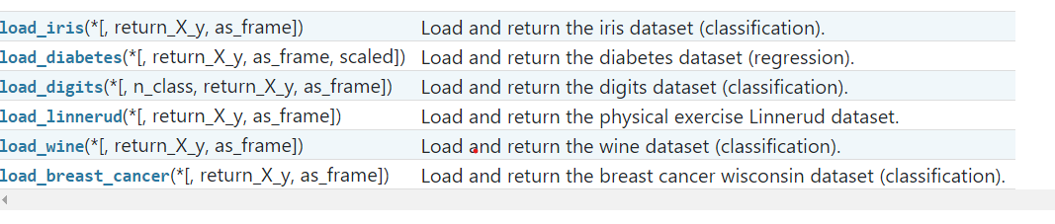
1. Sklearn Datasets
As mentioned in previous lessons, scikit-learn comes with a few small standard datasets that do not require to download any file from some external website.
They can be loaded using the following functions:
https://scikit-learn.org/stable/datasets/toy_dataset.html

Slide 4
2. IRIS Plants Dataset
The Iris dataset contains the measurements of 150 iris flowers from 3 different species:
    Iris-Setosa,
    Iris-Versicolor
    Iris-Virginica.

Slide 5
2. IRIS Plants Dataset
These datasets are useful to quickly illustrate the behavior of the various algorithms implemented in scikit-learn.

Slide 6
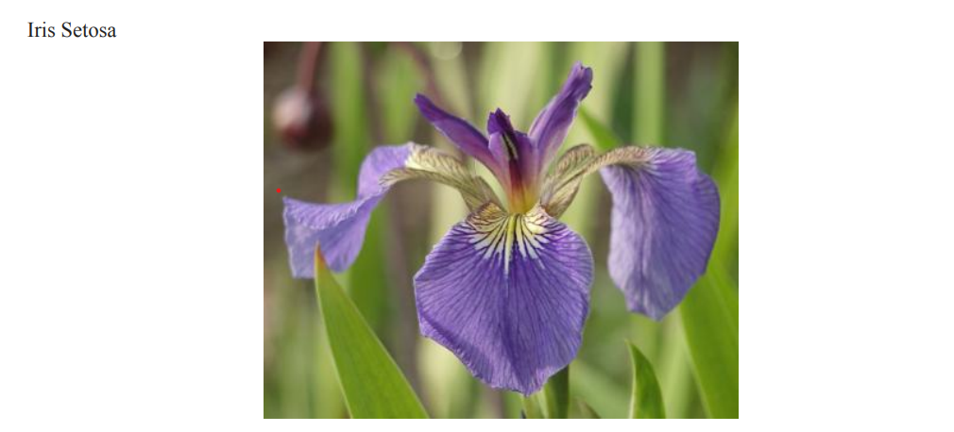
2. IRIS Plants Dataset

Slide 7
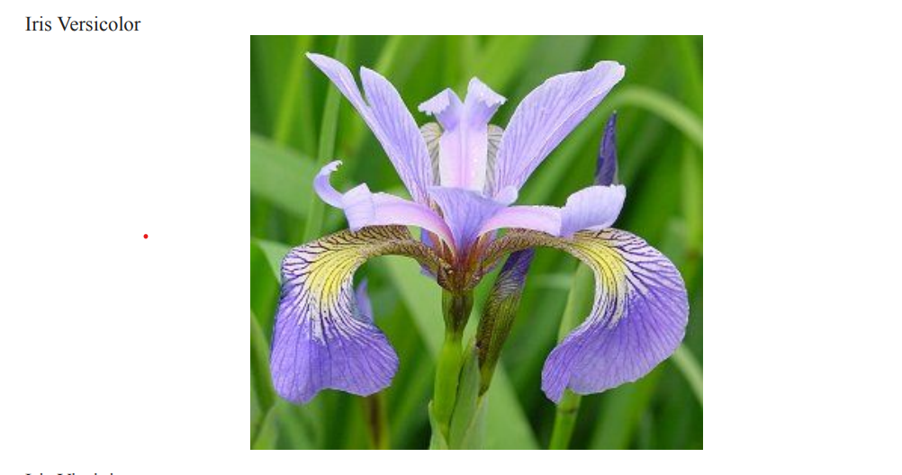
2. IRIS Plants Dataset

Slide 8
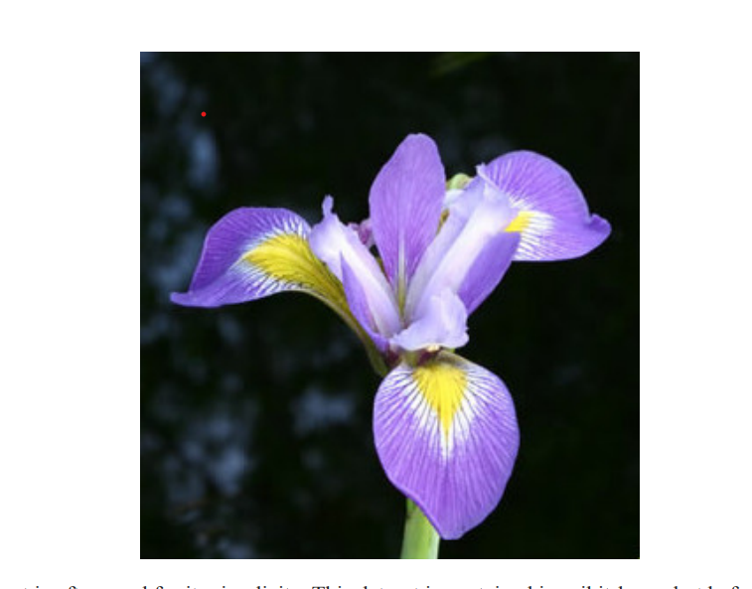
2. IRIS Plants Dataset
Iris Virginica

Slide 9
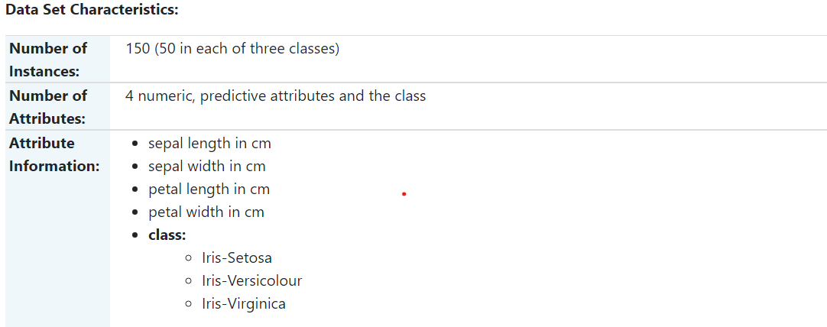
2. IRIS Plants Dataset
These datasets are useful to quickly illustrate the behavior of the various algorithms implemented in scikit-learn.

Slide 10
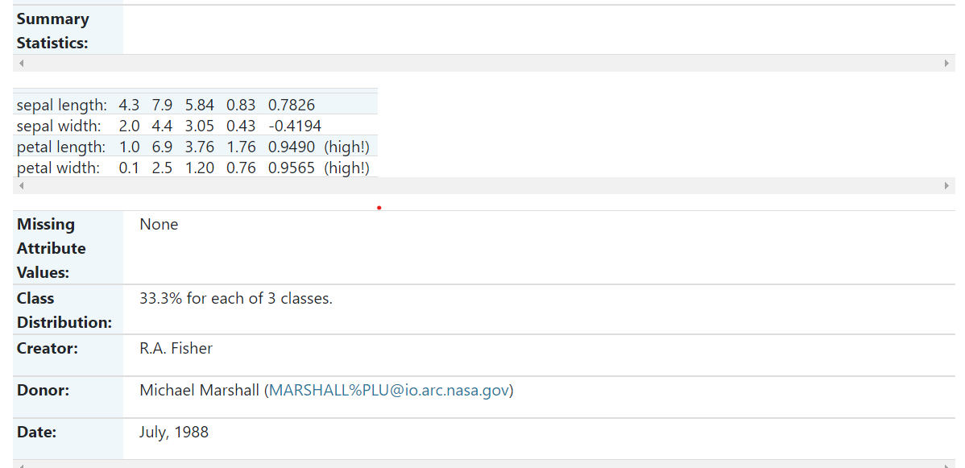
2. IRIS Plants Dataset

Slide 11
2. IRIS Plants Dataset
The famous Iris database, first used by Sir R.A. Fisher.
The dataset is taken from Fisher’s paper.
Note that it’s the same as in R, but not as in the UCI Machine Learning Repository, which has two wrong data points
.

Slide 12
2. IRIS Plants Dataset
This is perhaps the best known database to be found in the pattern recognition literature.
Fisher’s paper is a classic in the field and is referenced frequently to this day. (See Duda & Hart, for example.)
The data set contains 3 classes of 50 instances each, where each class refers to a type of iris plant.
One class is linearly separable from the other 2; the latter are NOT linearly separable from each other.

Slide 13
3. Diabetes Dataset
Ten baseline variables, age, sex, body mass index, average blood pressure, and six blood serum measurements were obtained for each of n = 442 diabetes patients, as well as the response of interest, a quantitative measure of disease progression one year after baseline.

Slide 14
3. Diabetes Dataset
as well as the response of interest, a quantitative measure of disease progression one year after baseline.

Slide 15
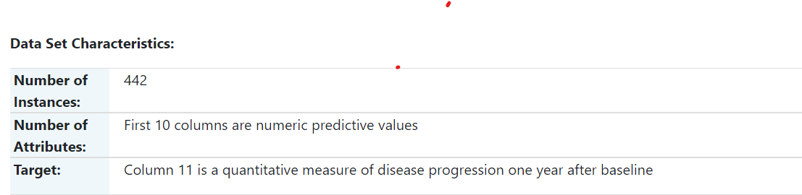
3. Diabetes Dataset

Slide 16
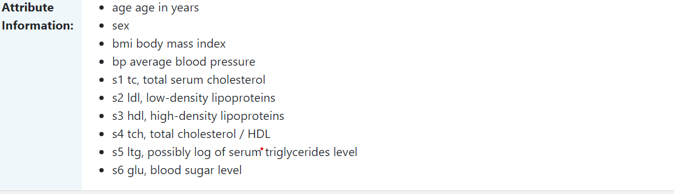
3. Diabetes Dataset

Slide 17
3. Diabetes Dataset
Note: Each of these 10 feature variables have been mean centered and scaled by the standard deviation times the square root of n_samples (i.e. the sum of squares of each column totals 1).

Slide 18
3. Diabetes Dataset
Source URL: https://www4.stat.ncsu.edu/~boos/var.select/diabetes.html
For more information see: Bradley Efron, Trevor Hastie, Iain Johnstone and Robert Tibshirani (2004) “Least Angle Regression,” Annals of Statistics (with discussion), 407-499. (https://web.stanford.edu/~hastie/Papers/LARS/LeastAngle_2002.pdf)

Slide 19
3. Diabetes Dataset
See for description of other Sklearn datasets
https://scikit-learn.org/stable/datasets/toy_dataset.html

Slide 20
Outline:
Introduction
Scikit-learn and Loading Iris CSV file
3. Printing the Information About the Class

Slide 21
1. Introduction
Scikit-learn has a very straightforward set of data on these iris species.
The data consist of the following:
• Features in the Iris dataset:
sepal length in cm
sepal width in cm

Slide 22
1. Introduction
Scikit-learn has a very straightforward set of data on these iris species.
The data consist of the following:
3. petal length in cm
4. petal width in cm

Slide 23
1. Introduction
Target classes to predict:
Iris Setosa
Iris Versicolour
Iris Virginica

Slide 24
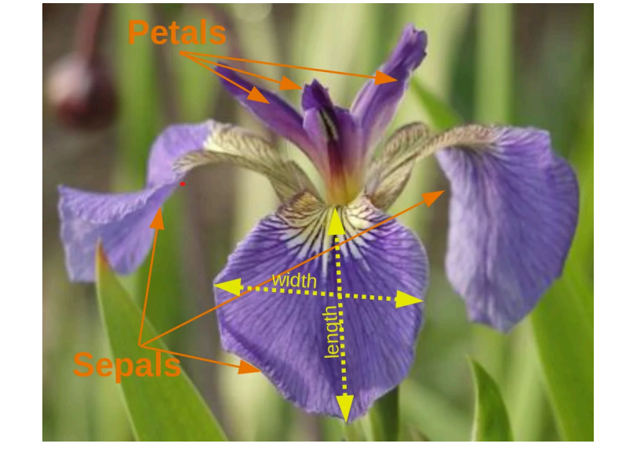
1. Introduction

Slide 25
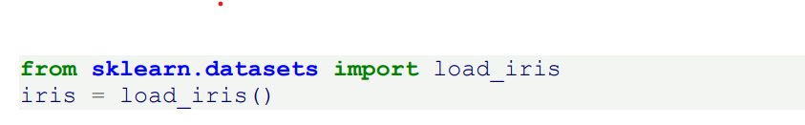
2. Scikit-learn Loading Iris CSV file
Importing the library and loading the data

Slide 26
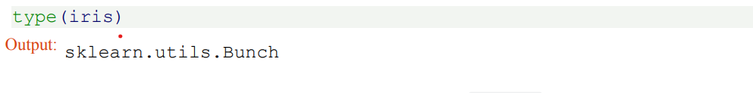
2. Scikit-learn Loading Iris CSV file
The resulting dataset is a Bunch object:

Slide 27
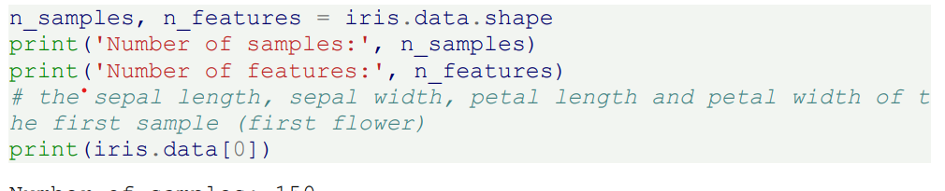
2. Scikit-learn Loading Iris CSV file
The features of each sample flower are stored in the data attribute of the dataset

Slide 28
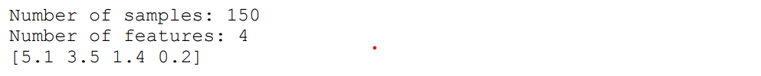
2. Scikit-learn Loading Iris CSV file
The features of each sample flower are stored in the data attribute of the dataset

Slide 29
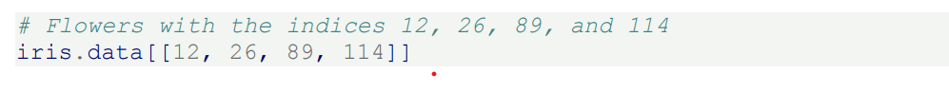
2. Scikit-learn Loading Iris CSV file
The feautures of each flower are stored in the data attribute of the data set.
Let's take a look at some of the samples:

Slide 30
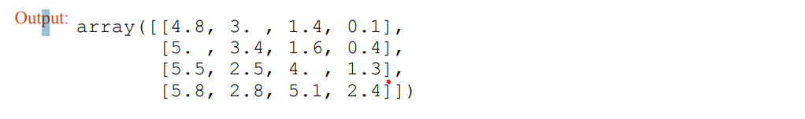
2. Scikit-learn Loading Iris CSV file

Slide 31
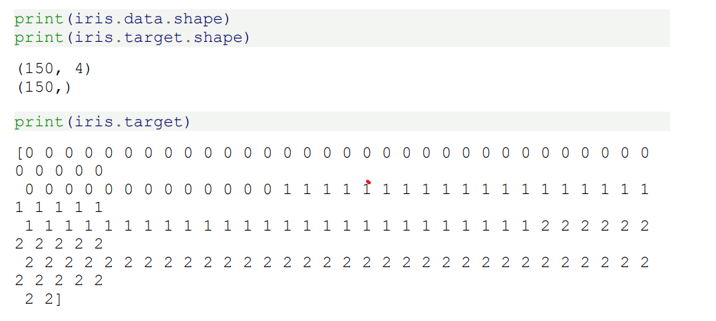
3. Printing the Information About the Class
The information about the class of each sample, i.e. the labels, is stored in the "target" attribute of the data set

Slide 32
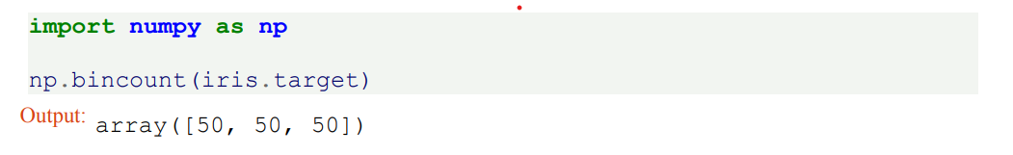
3. Printing the Information About the Class
The information about the class of each sample, i.e. the labels, is stored in the "target" attribute of the data set
Using NumPy's bincount function (above) we can see that the classes in this dataset are evenly distributed -

Slide 33
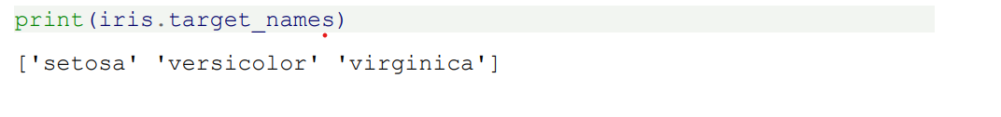
3. Printing the Information About the Class
There are 50 flowers of each species, with
• class 0: Iris Setosa
• class 1: Iris Versicolor
• class 2: Iris Virginica
These class names are stored in the last attribute, namely target_names :

Slide 34
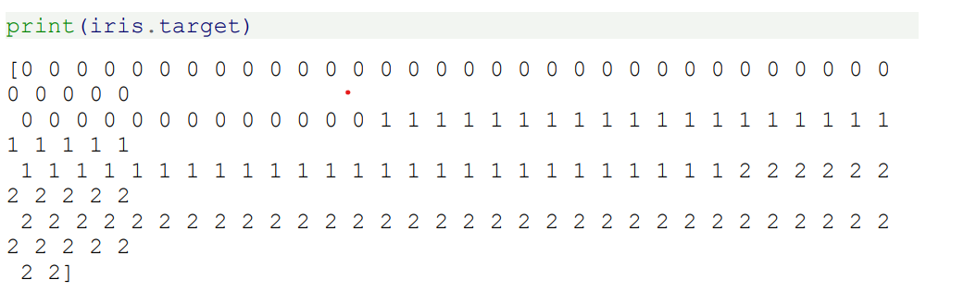
3. Printing the Information About the Class
The information about the class of each sample, i.e. the labels, is stored in the "target" attribute of the data set
Beside of the shape of the data, we can also check the shape of the labels, i.e. the target.shape : Each flower sample is one row in the data array, and the columns (features) represent the flower measurements in centimeters. For instance, we can represent this Iris dataset, consisting of 150 samples and 4 features, a 2-dimensional array or matrix R 150 × 4 in the following format:

Slide 35
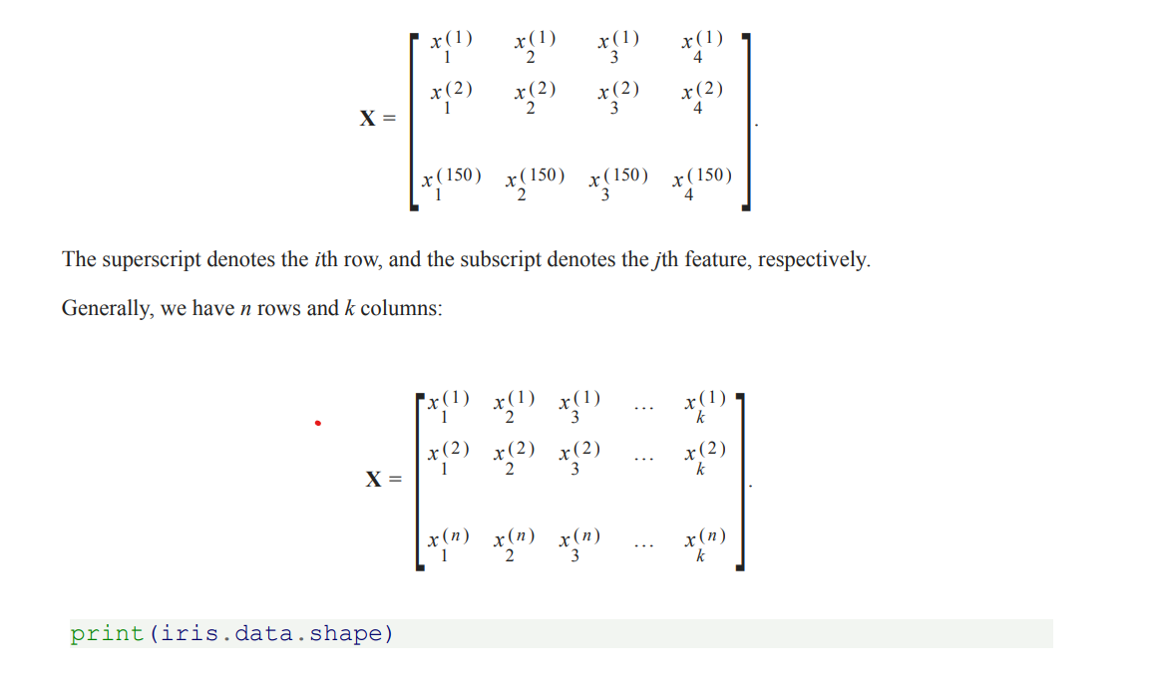
3. Printing the Information About the Class

Slide 36
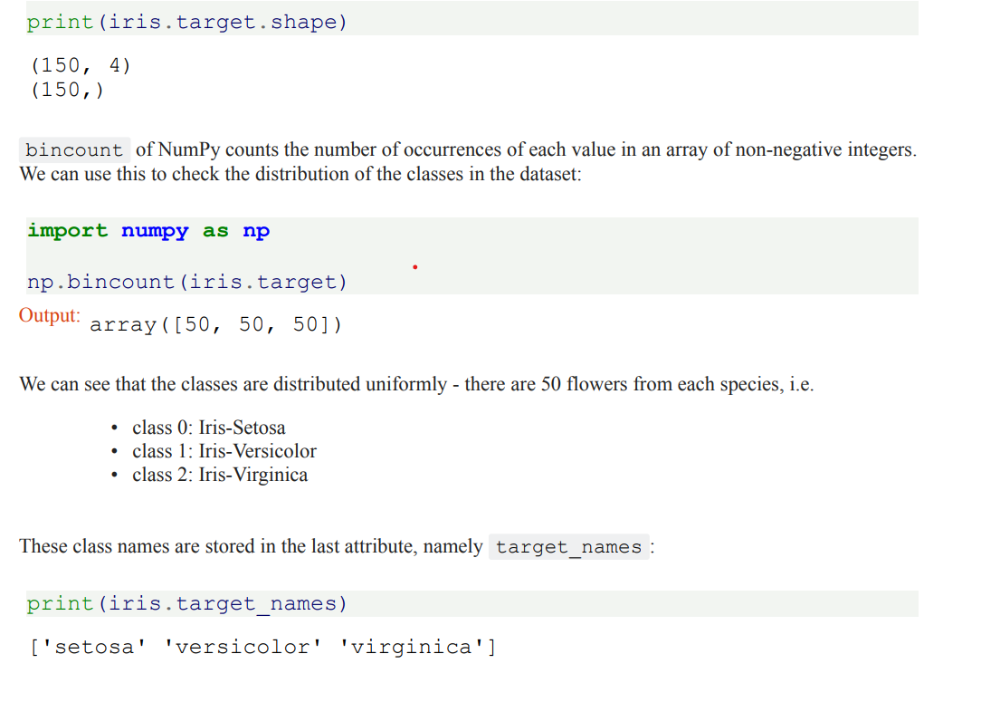
3. Printing the Information About the Class

Slide 37
Visualising the Features of the Iris Data Set

Slide 38
Outline:
Features óf Iris Datasets
Description of IRIS Plant Datasets
3. Description of Diabetes Dataset

Slide 39
1. Features of Iris Datasets
We can see that the classes are distributed uniformly - there are 50 flowers from each species,
i.e.
• class 0: Iris-Setosa
• class 1: Iris-Versicolor

Slide 40
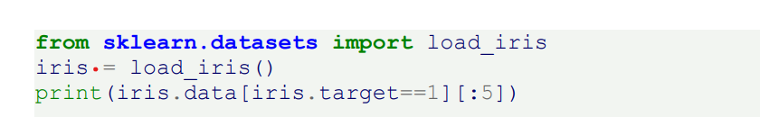
1. Features of Iris Datasets
• class 2: Iris-Virginica
These class names are stored in the last attribute, namely target_names

Slide 41
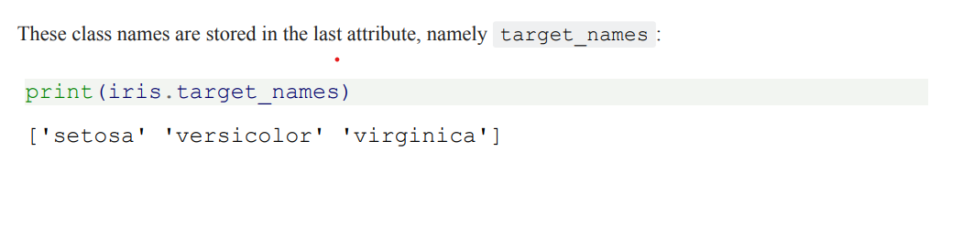
1. Features of Iris Datasets
These class names are stored in the last attribute, namely target_names

Slide 42
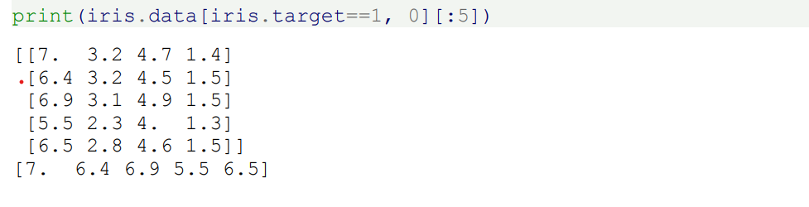
1. Features of Iris Datasets
These class names are stored in the last attribute, namely target_names

Slide 43
1. Features of Iris Datasets
The feauture data is four dimensional, but we can visualize one or two of the dimensions at a time using a simple histogram or scatter-plot.

Slide 44
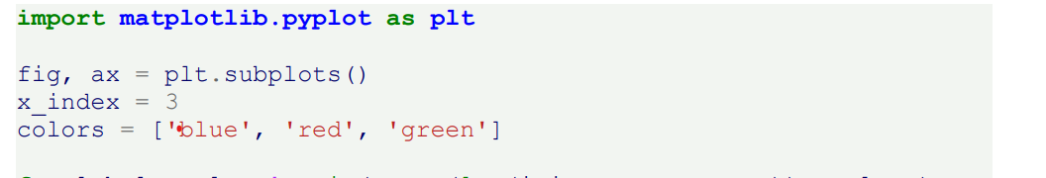
2.Histograms of The Features

Slide 45
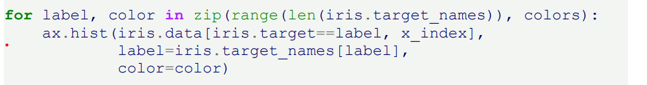
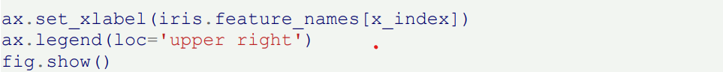
2.Histograms of The Features

Slide 46
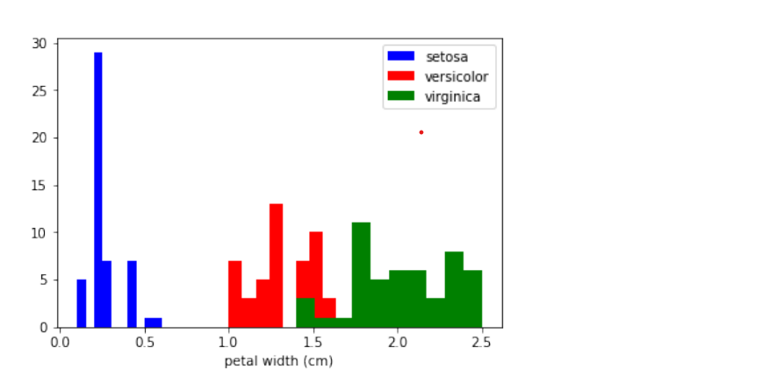
2.Histograms of The Features

Slide 47
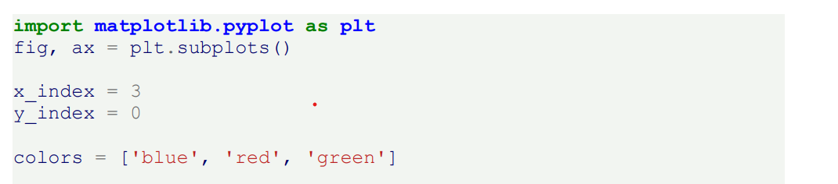
3. Scatterplot With Two Features
The appearance diagram shows two features in one diagram

Slide 48
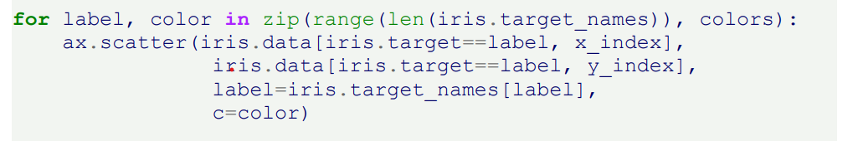
3. Scatterplot With Two Features
The appearance diagram shows two features in one diagram

Slide 49
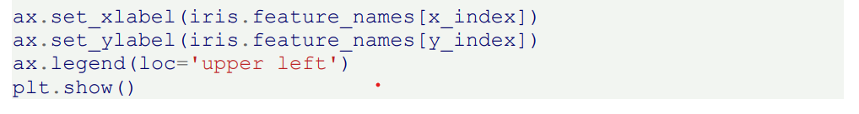
3. Scatterplot With Two Features

Slide 50
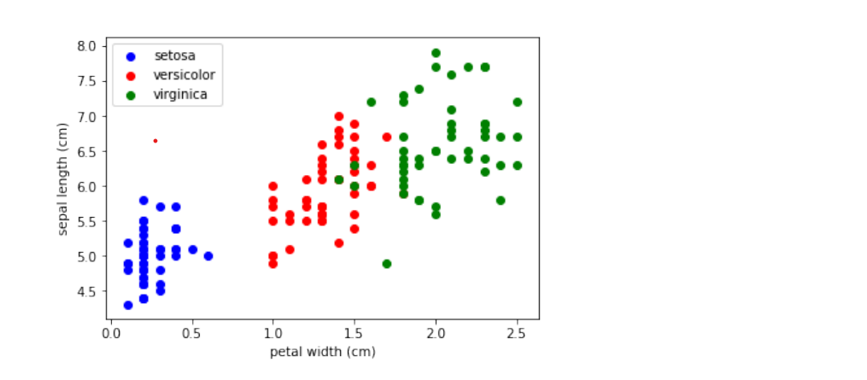
3. Scatterplot With Two Features

Slide 51
1. Learn, Test and Evaluation Data
You have your data ready and you are eager to start training the classifier?
But be careful: When your classifier will be finished, you will need some test data to evaluate your classifier.
If you evaluate your classifier with the data used for learning, you may see surprisingly good results.
What we actually want to test is the performance of classifying on unknown data.

Slide 52
1. Learn, Test and Evaluation Data
For this purpose, we need to split our data into two parts:
A training set with which the learning algorithm adapts or learns the model
A test set to evaluate the generalization performance of the model

Slide 53
1. Learn, Test and Evaluation Data
When you consider how machine learning normally works, the idea of a split between learning and test data makes sense.
Really existing systems train on existing data and if other new data (from customers, sensors or other sources) comes in, the trained classifier has to predict or classify this new data.
We can simulate this during training with a training and test data set - the test data is a simulation of "future data" that will go into the system during production.

Slide 54
1. Learn, Test and Evaluation Data
We will learn how to do the splitting with plain Python.
We will see also that doing it manually is not necessary, because the train_test_split function from the model_selection module can do it for us. If the dataset is sorted by label, we will have to shuffle it before splitting.

Slide 55
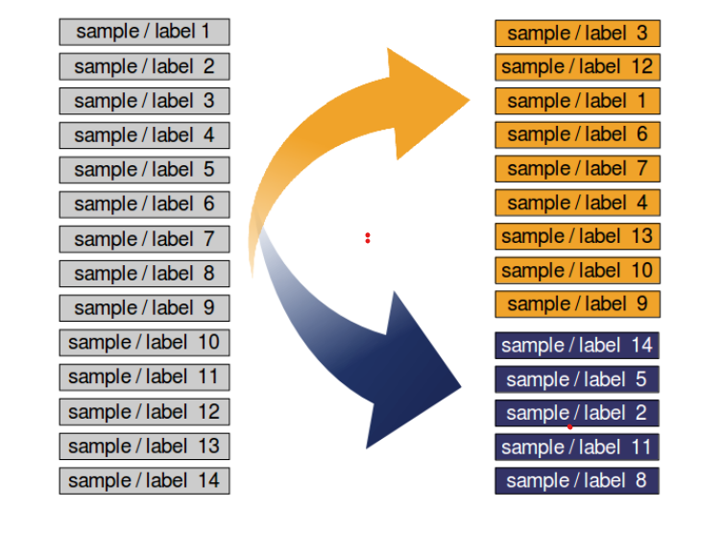
1. Learn, Test and Evaluation Data

Slide 56
1. Learn, Test and Evaluation Data
Dataset can be separated into a learn (a.k.a. training) dataset and a test dataset.
Best practice is to split it into a learn, test and an evaluation dataset.
We will train our model (classifier) step by step and each time the result needs to be tested. If we just have a test dataset. The results of the testing might get into the model

Slide 57
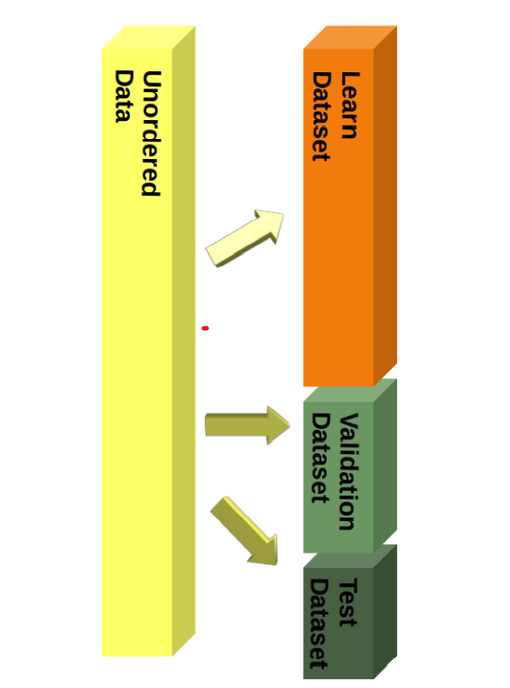
1. Learn, Test and Evaluation Data
So we will use an evaluation dataset for the complete learning phase.
When our classifier is finished, we will check it with the test dataset, which it has not "seen" before!

Slide 58
2. Splitting Example: Iris Data Set
We will demonstrate the previously discussed topics with the Iris Dataset.
The 150 data sets of the Iris data set are sorted, i.e. the first 50 data correspond to the first flower class (0 = Setosa), the next 50 to the second flower class (1 = Versicolor) and the remaining data correspond to the last class (2 = Virginica).
If we were to split our data in the ratio 2/3 (learning set) and 1/3 (test set), the learning set would contain all the flowers of the first two classes and the test set all the flowers of the third flower class.

Slide 59
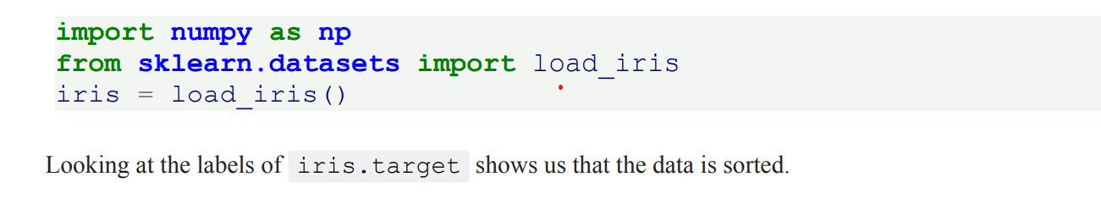
2. Splitting Example: Iris Data Set
The classifier could only learn two classes and the third class would be completely unknown.
So we urgently need to mix the data. Assuming all samples are independent of each other, we want to shuffle the data set randomly before we split the data set as shown above.
The Data is Split manually as follows:

Slide 60
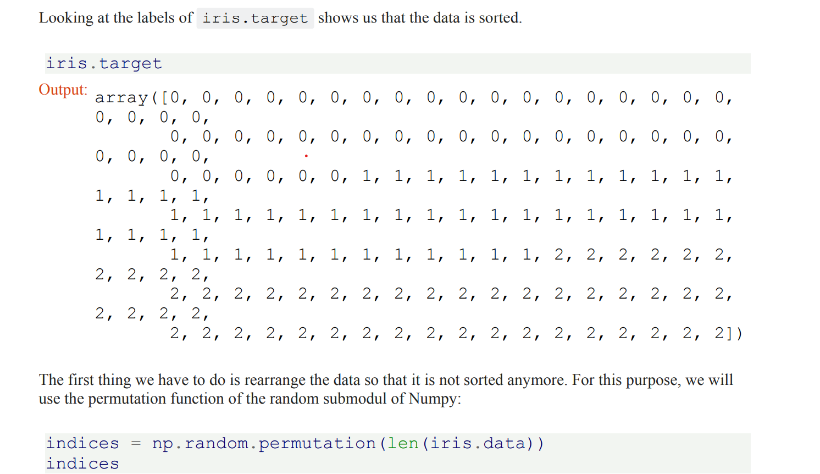
2. Splitting Example: Iris Data Set

Slide 61
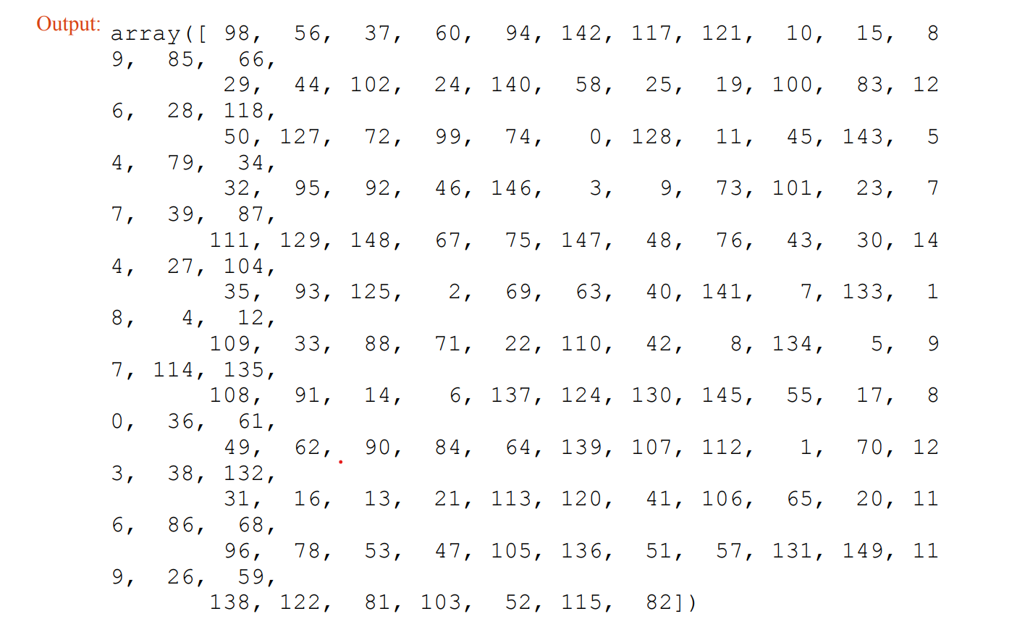
2. Splitting Example: Iris Data Set

Slide 62
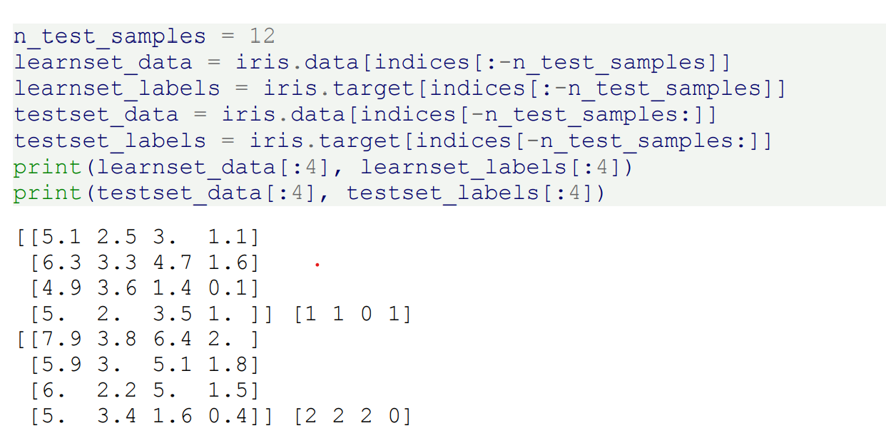
2. Splitting Example: Iris Data Set

Slide 63
3. Split with Sklearn
Even though it was not difficult to split the data manually into a learn (train) and an evaluation (test) set, we don't have to do the splitting manually as shown above.
Since this is often required in machine learning, scikitlearn has a predefined function for dividing data into training and test sets.

Slide 64
3. Split with Sklearn
We will demonstrate this below. We will use 80% of the data as training and 20% as test data. We could just as well have taken 70% and 30%, because there are no hard and fast rules.
The most important thing is that you rate your system fairly based on data it did not see during exercise! In addition, there must be enough data in both data sets. .

Slide 65
3. Split with Sklearn
Stratified Random Sample
Especially with relatively small amounts of data, it is better to stratify the division. Stratification means that we keep the original class proportion of the data set in the test and training sets. We calculate the class proportions of the previous split in percent using the following code. To calculate the number of occurrences of each class, we use the numpy function 'bincount'. It counts the number of occurrences of each value in the array of non-negative integers passed as an argument.

Slide 66
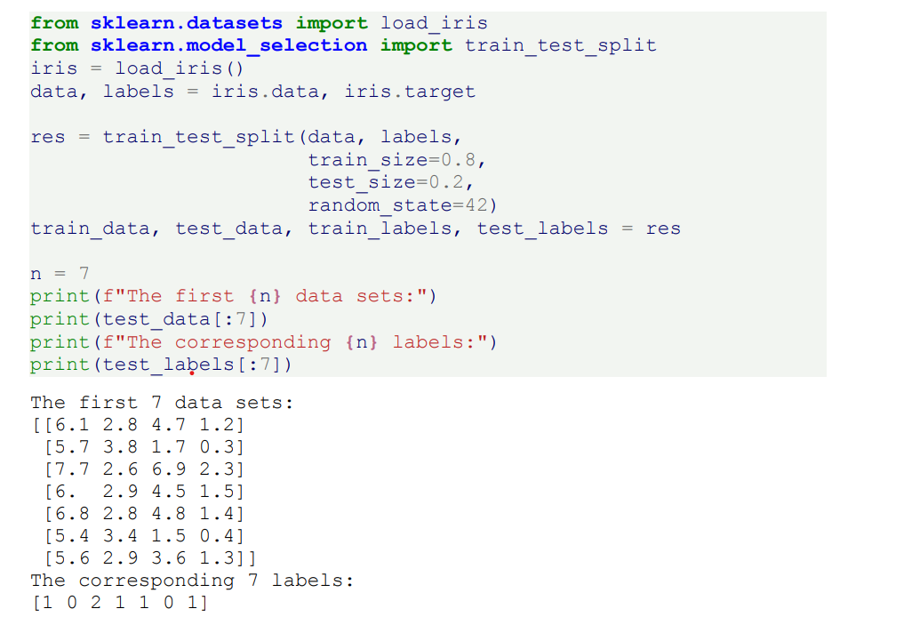
3. Split with Sklearn

